Slide 1
Link article to one specific issue of a journal (using 773)
Yoel Kortick – Senior Librarian

Slide 2
Link to one specific issue of many issues of a journal
We will now:
Link from a bibliographic record which is an article and has no items to one of 6 issues of a related journal (to the issue where the article is located).
Use 773 sub field w to link to the 035 of the related bibliographic record.
Use 773 sub field g to link to the specific issue enumeration level a, b and c and also year.

Slide 3
Link to one specific issue of many issues of a journal
When the host record has several items the subfield g can point to a specific item.
The subfield g will contain the following text followed by the actual value (example to follow):
Year yr:
Volume or barcode: no:
Part pt:
Issue iss:
Pages p:

Slide 4
Link to one specific issue of many issues of a journal
As we will see on the next slide:
The “Journal of Library Science in China” has 6 issues.
We will link to an article in: Vol. 3 Iss. 2 Part 2. (2013)

Slide 5
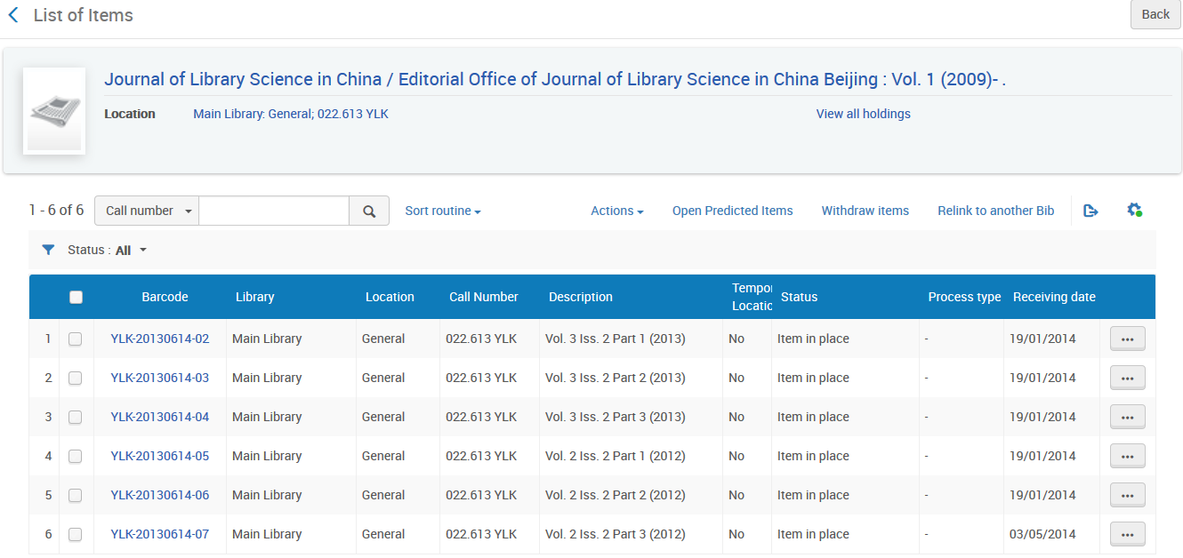

Link to one specific issue of many issues of a journal
We will link to:
Vol. 3 Iss. 2 Part 2. (2013)

Slide 6
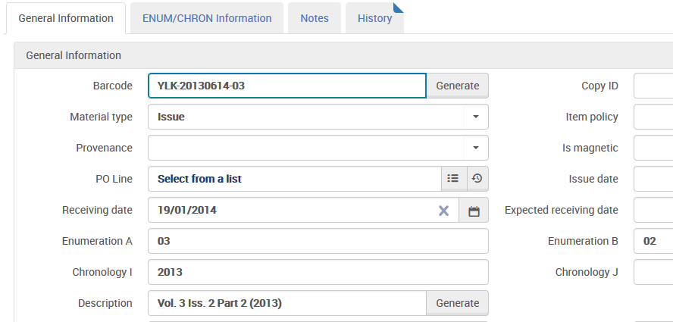
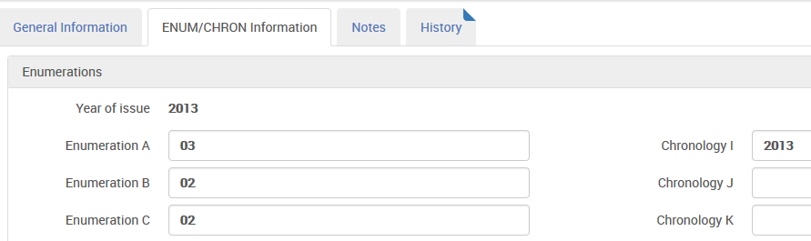
Link to one specific issue of many issues of a journal
Here is the item we will link to
This is the year, volume and issue to which we will link

Slide 7

Link to one specific issue of many issues of a journal
Here is the bibliographic record of the catalogued article.
Here we use sub field w to point to 035 field of host record.
Here we use an elaborate combination of subfields g to point to a specific item. The article is in Volume 3, Issue 2, Part2 (Year 2013) of the Journal of library science in China

Slide 8
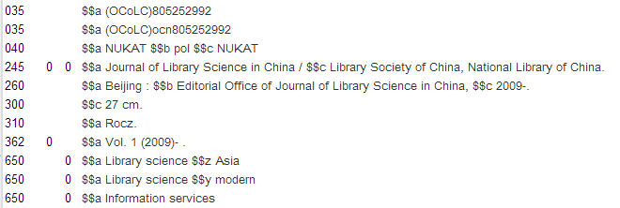
Link to one specific issue of many issues of a journal
Bibliographic links between the records

Slide 9
Link to one specific issue of many issues of a journal
Item links between the records

Slide 10
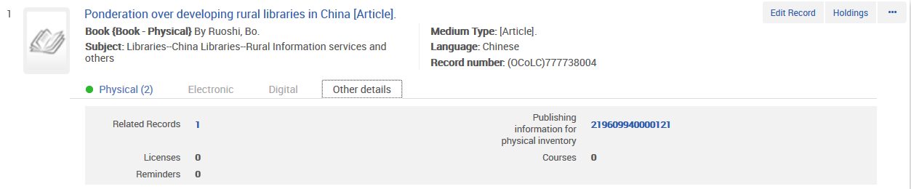
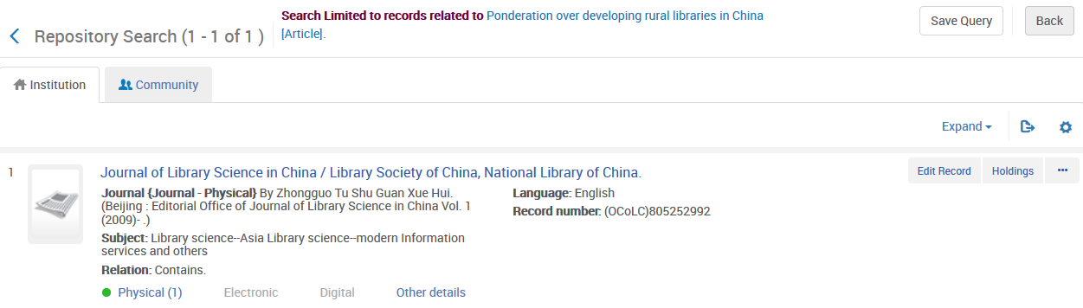
Link to one specific issue of many issues of a journal
This is the search results in Alma searching for article “Ponderation over developing rural libraries in China”

Slide 11
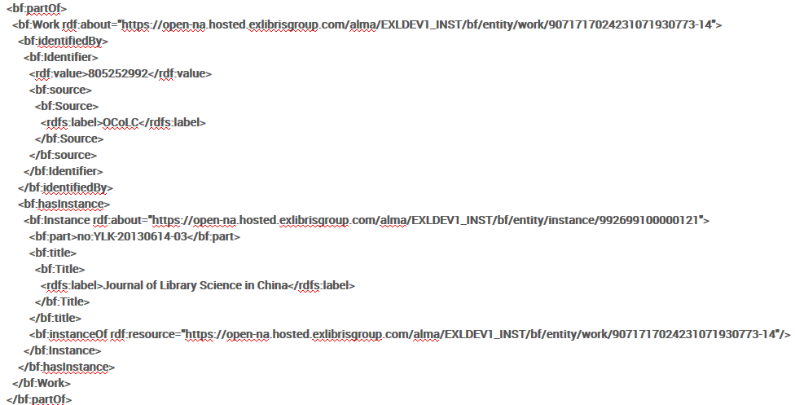
Link to one specific issue of many issues of a journal
This is the BIBFRAME results in Alma searching for article “Ponderation over developing rural libraries in China” (partOf)

Slide 12
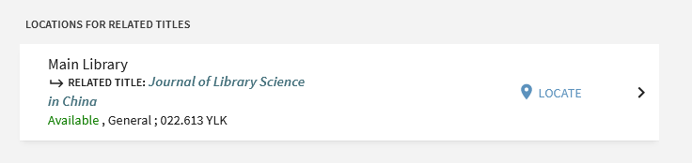
Link to one specific issue of many issues of a journal
If we search in Primo for the article “Ponderation over developing rural libraries in China” then the GetIt tab will point to the related record
This will link directly to the inventory of the Journal in Primo

Slide 13
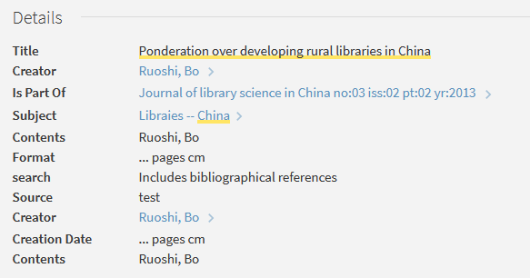
Link to one specific issue of many issues of a journal
If we search in Primo for the article “Ponderation over developing rural libraries in China” then the “Details” will point to the related record
This will link directly to the Journal in Primo

Slide 14
xxx@exlibrisgroup.com

